Slide 1
dataflow
Dr3
.ipynb
Dr3
.ipynb
Oip_mega_rounded1.csv
93293 / p,v,fp,mb
Dr3
.ipynb
Yf API
C,v
Oipmega_post_yf1.csv
93293 / p,v,fp,mb
Your_file_cleaned.csv
93293 / p,v,fp,mb
D3_yf_errors_by_ticker_wdata2.csv
4389 (2000) / ticker error dict
Oip_mega_wreturns.csv
ADD#r / p,v,fp,mb,r
oi_rawpull_ymd_2019_01_01_2025_08_06_incl.csv 93293 / OI data only
Manual data find
~2000
New source col(s)
Oip_mega_wreturns.csv
Yf API
Ohlc->sig
Auto pull from new sources
O,h,l,c,v
Volget9.py
(drop if p_m1_td na)
Barchart_ripper.py
Make dynamic/reusable
Dr1b+dr2+3.ipynb???
Oip_mega_wretvol.csv
recaptured.csv
O,h,l,c,v by ticker
Yf API
Oip_mega_wretvol.csv
73495 / p,v,fp,mb,r,sig
Openinsider.com
Get S&P500 daily OHLCV, compute daily returns
Sigma compute, trade-wise slice
Merge py
snp500.csv
#? / o,h,l,c,v,r
ogmissingtrades.csv
P,v,mb,etc by trade
Oip_mega_filled.csv
~92000? / p,v,fp,mb,sig
Oip_mega_features.csv
~92000? / p,v,fp,mb,sig,%,normed
~N + log() transforms of distributed ft variables (by ticker? By var? by yr?
Relative weighting of volume, insider buy data by ticker avg/total?– more ft cols
Oip_mega_relative.csv
~92000? / p,v,fp,mb,sig,%
Notes:
Andes to local file port ex: PS C:\Users\John DeForest\Desktop\stonx> scp f00569n@andes.dartmouth.edu:~/stonx1/oip_mega_wretvol.csv .

Slide 2
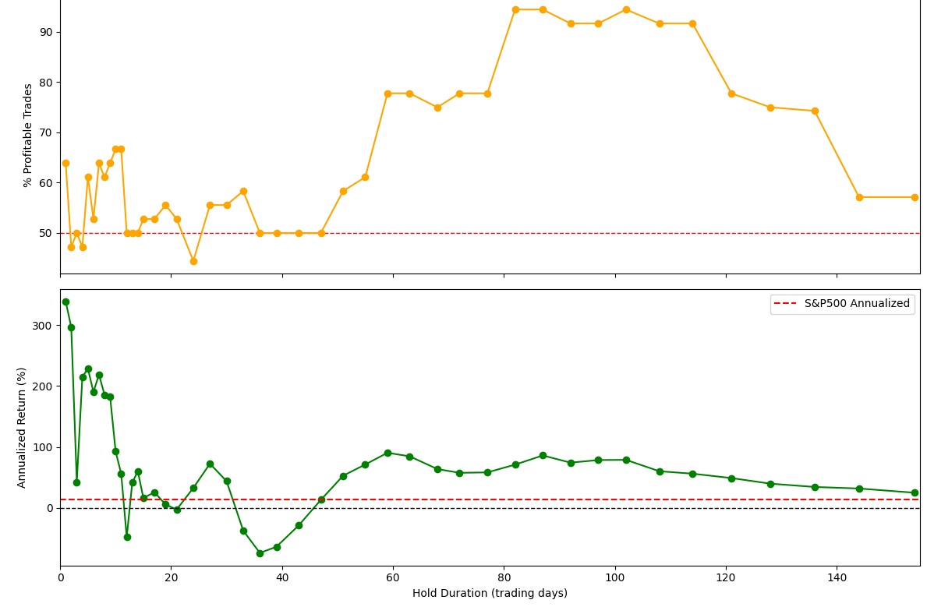
modelflow
Naïve Fixed-Hold_dur
1-150d
Og RF: pred if pos return in next65?
Use hist data by ticker? To pred if fixed hold works? Use insider hist performance?
Works ov On some Tickers
1-7 or 45-65 ie MCB ☺
All neg/0 for ticker for all hold_durs ☹
Look at rolling?
dynamic hold_dur
NO-BUY
Test rolling %win/PnL over time for maxDrawdown
MonteCarlo/Rolling updater
Prob stays Pos/Neg
E[x} fwd pred
Test predicted hold duration PnL (even tho low accuracy, might be directionally/roughly correct?)
Search #hold_duration_multiclass in dr3
Bc tbh I would only count as inaccurate if it ends up NOT positive at the pred hold dur (rather than counting as 0/fail if it isn’t the highest at pred_hold_dur
Test rolling %win/PnL over time for maxDrawdown

Slide 3
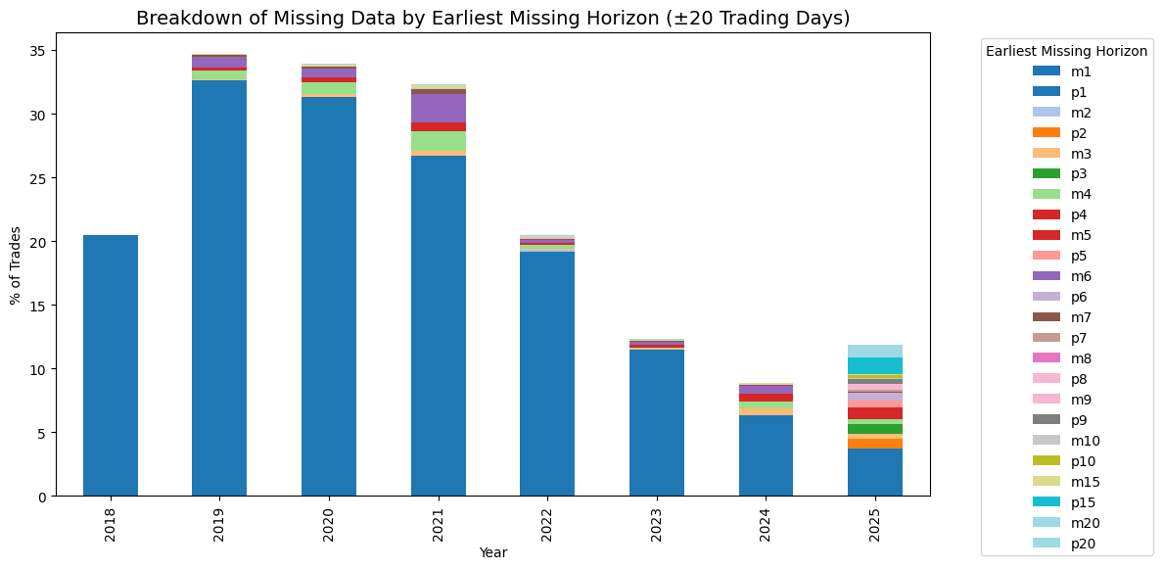
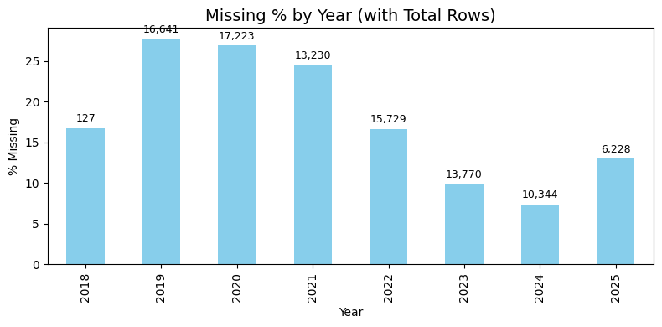
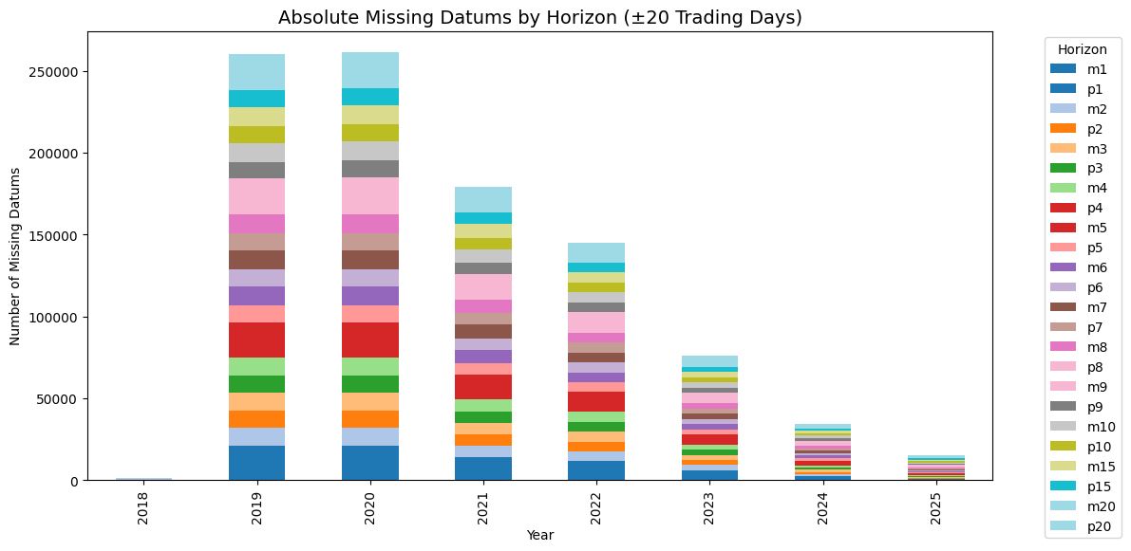
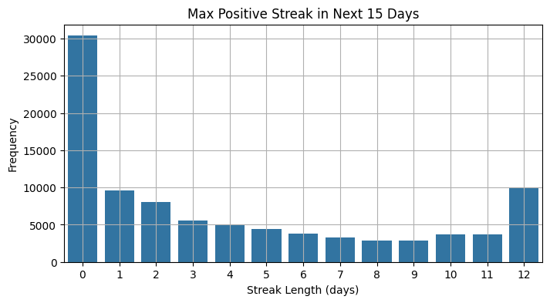
Notings – missing data is often missing for all times, better coverage recently

Slide 4
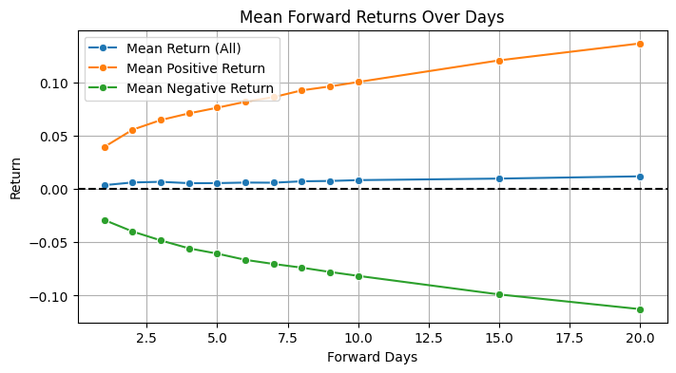
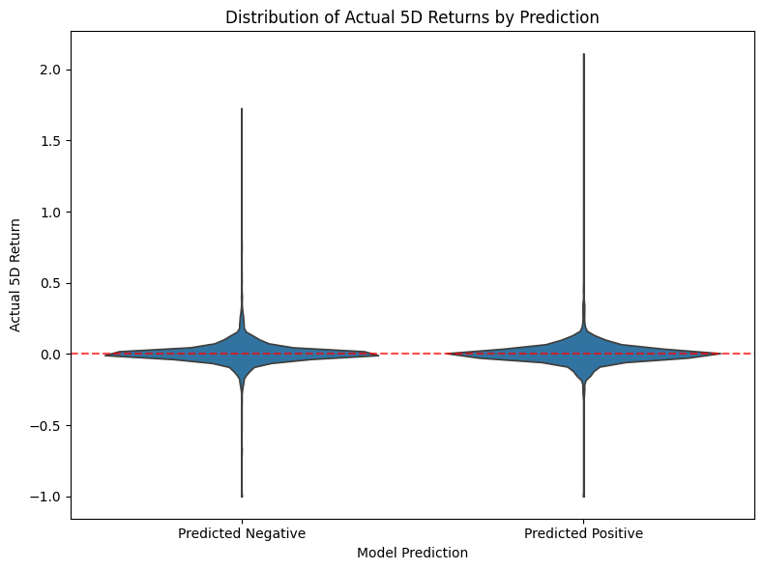
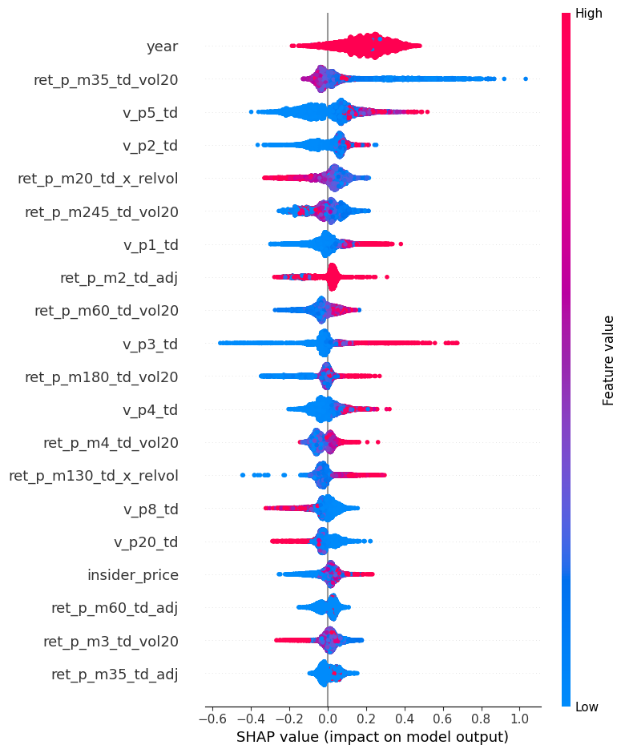
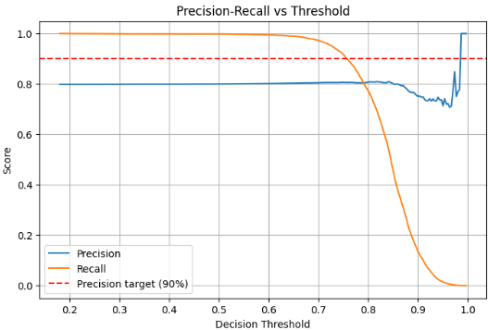
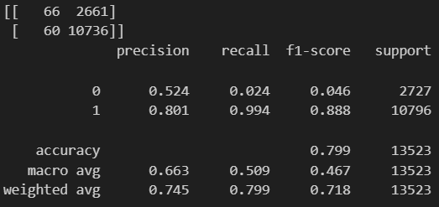
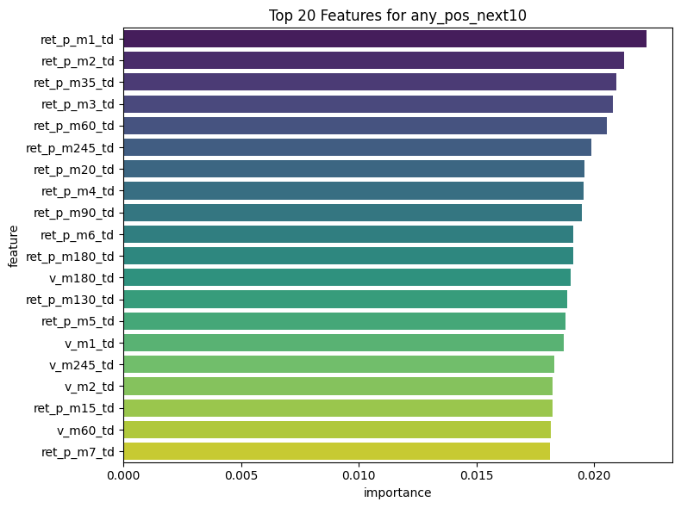

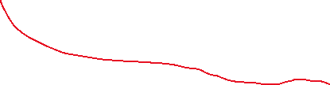

notings2
SHAP takes forever to run, super basic models so far suck, prediction necessary (naïve buying might not work overall)
Basic any+ in next10d:
80% precision @best thresh= 0.6 see below
Dropped 25347r due2 missing lookback data; remaining 67945 rows. Dropped 333 rows due to missing forward ret_p_p1..p10 data; remaining 67612 rows. Number of features after excluding future cols: 64.
(I think this is with 80/20 train/test split)

Slide 5
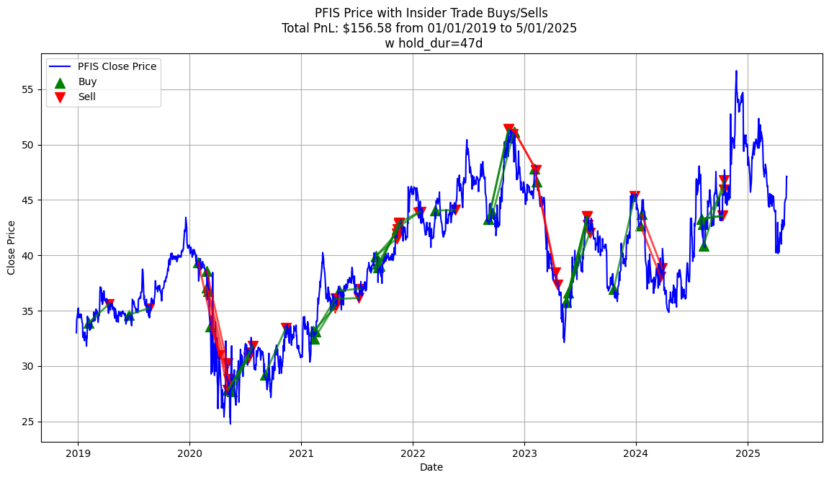
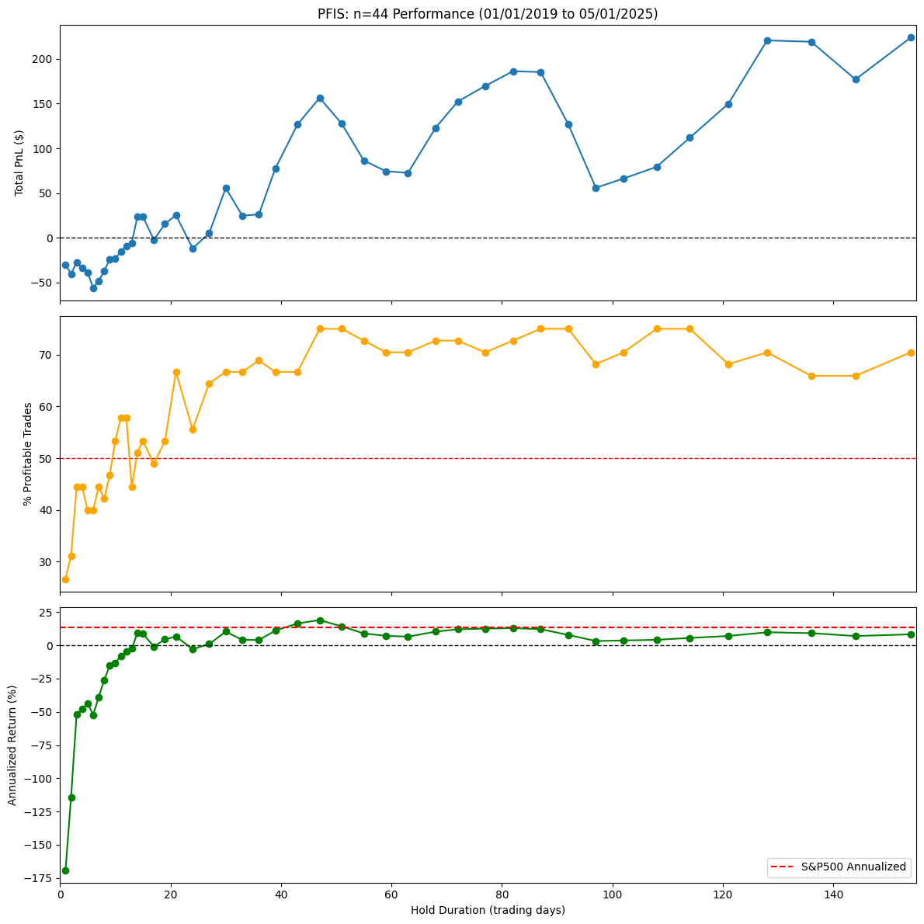
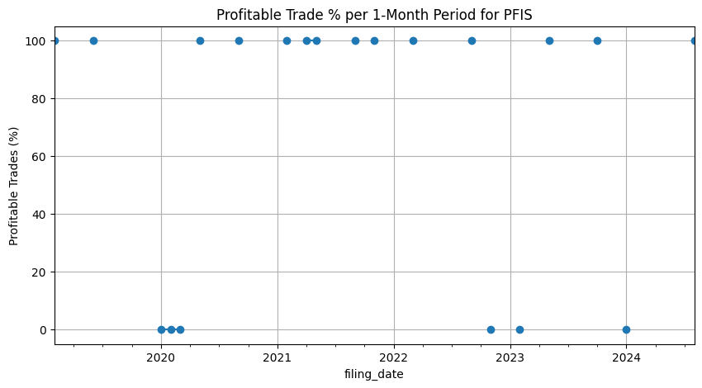
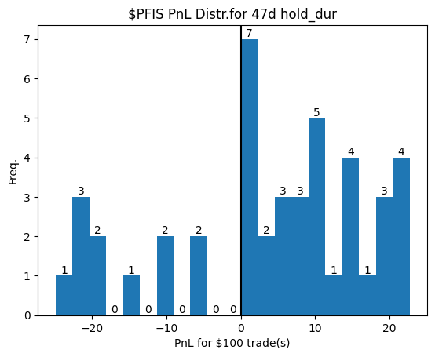
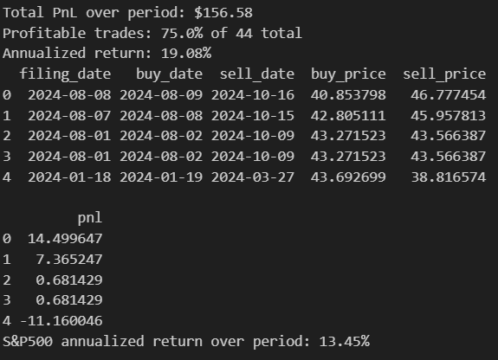
Notings3 – naïve buying testing (baseline)
Iff fixed, hold_dur should be individualized by ticker (classify?)
Ie: $PFIS meh mostly negative (relative to the S&P500)
See next page for posi example tho

Slide 6
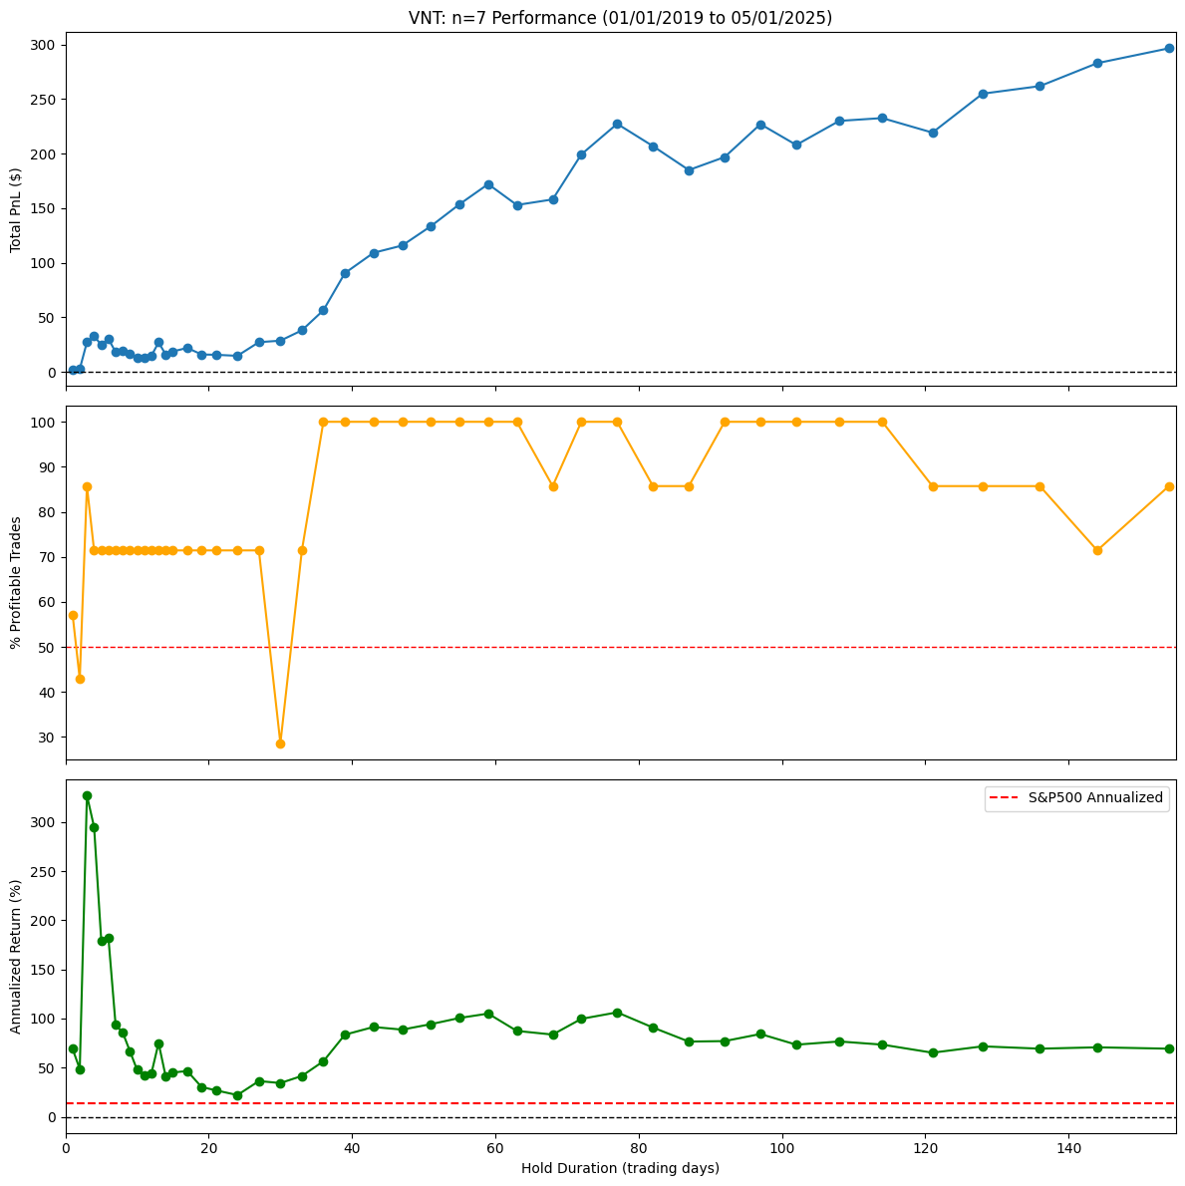
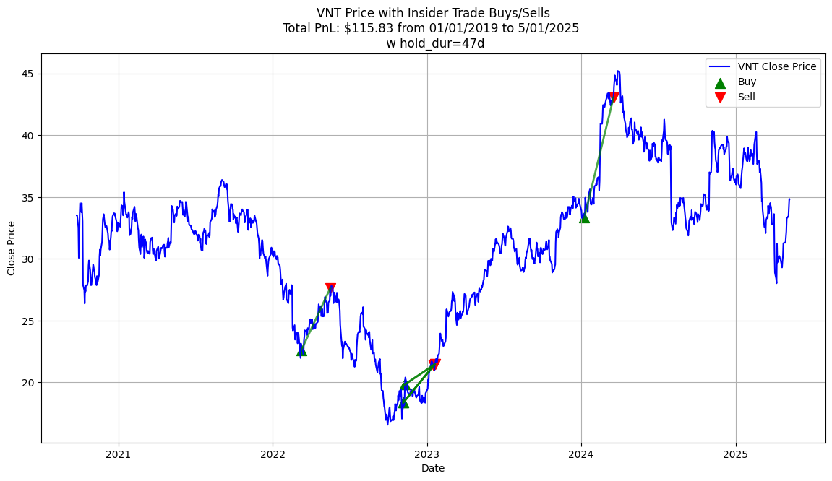
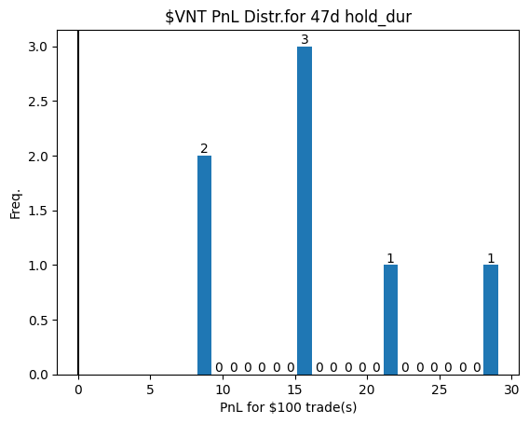
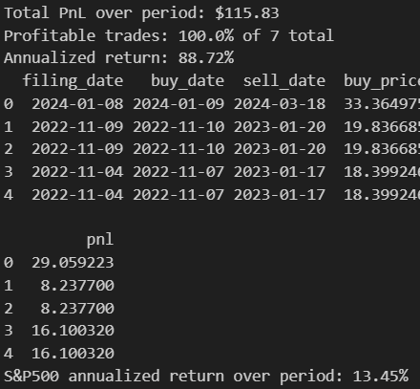
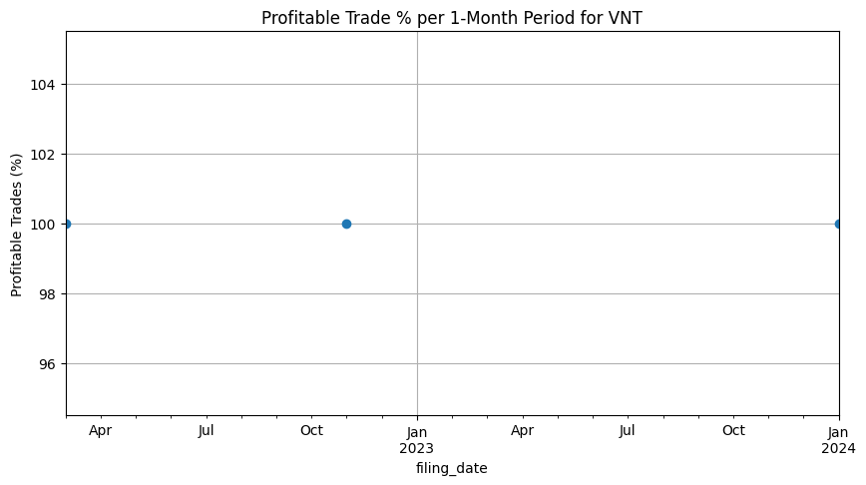
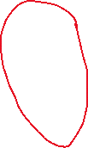


Notings4 – naïve buying cont.
Posi ex of fixed hold_dur: $VNT
45-70 hold_dur region was good for quite a few sampled stocks

